Slide 1
Tech Lit

Slide 2
What Is Networking?
Networking is the exchange of information or services among individuals, groups, or institutions
Networks are used almost everywhere. Without them you would not have the internet or be able to log in to the computers at school/work. Many tasks that you use a computer for would become almost impossible

Slide 3



What Is a Network Device?
An item that use networks or have internet access. Example: Computers, cell phones, and gaming consoles

Slide 4
NETWORK TYPES
LAN
Local Area Network
LAN supplies networking capability to a group of computers in close proximity to each other such as in an office building, a school, or a home. LAN is useful for sharing resources like files, printers, games or other applications.

Slide 5
NETWORK TYPES
MAN
Metropolitan Area Network
A metropolitan area network (MAN) is a network that interconnects users with computer resources in a geographic area or region
Designed for a town or city or a large university

Slide 6
NETWORK TYPES
WAN
Wide Area Network
A WAN spans a large geographic area, such as a state, province or country. WANs often connect multiple smaller networks, such as local area networks (LANs) or metro area networks (MANs).
The world's most popular WAN is the Internet.

Slide 7
NETWORK TYPES
WiFi
Wireless Fidelity
Wi-Fi refers to wireless networking that allows computers and other devices to communicate over a wireless signal

Slide 8
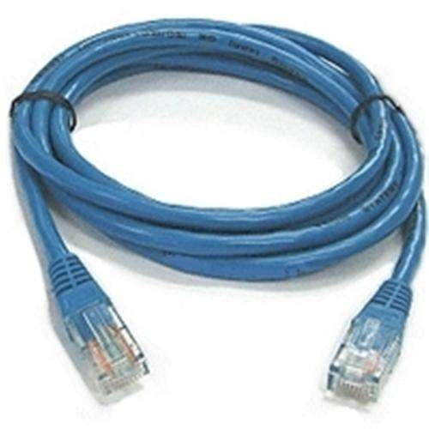
ETHERNET (A.K.A. Cat 5)
Definition
A type of network cable for local area networks
A coaxial cable which carries frequency signals between computers at a rate of 10 megabits per second
Ethernet Cable

Slide 9
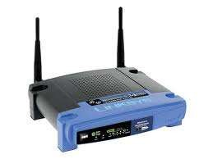
ROUTER
Definition
The primary function of the router is to connect networks together
It allows data to move from one network to another
It acts as a firewall to protect your computer from unwanted outside access to your network.
Router

Slide 10
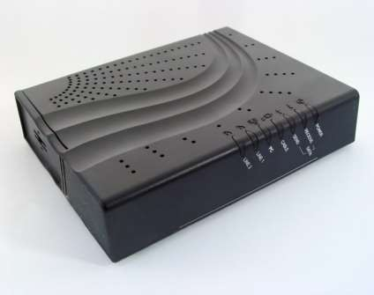
MODEM
Definition
Short for modulator-
demodulator.
A modem is a device or program that enables a computer to transmit data over a telephone or cable line
Modem

Slide 11
ISP
Internet Service Provider
Refers to a company that provides Internet services, including personal and business access to the Internet
Examples:
Windstream
AT & T
Time Warner
Verizon

Slide 12
IP
Internet Protocol
The method which information is sent between any two computers on the Internet
IP addresses are the backbone of networking, There are many levels and classes of IP addresses and also some are even reserved for special use.
The numbers in an IP Address go from 0-255

Slide 13
Example: IP ADDRESS
Auburn Laptop IP
Local IP Address (Auburn Secure)
10.30.18.21

Slide 14
TCP
Transmission Control Protocol
is a set of rules used along with the Internet Protocol to send data in the form of message units between computers over the internet
a protocol developed for the internet to get data from one network device to another;

Slide 15

INTERNET
INTERNET
Internet
World Wide Web
A global computer network providing a variety of information and communication facilities across the entire country and most of the world.

Slide 16

INTRANET
Intranet
Intranet
A computer network with restricted access within a company or school that uses software and protocols developed for the Internet

Slide 17

SERVER
Server
A server is a computer in a central location that runs software or stores data.
Multiple clients can connect to the server for their processing needs.

Slide 18

WEB BROWSER
Web Browser
A software application that allows for the browsing of the World Wide Web
computer program used for accessing sites or information on a network

Slide 19
DOMAIN NAME
Domain Name
Used to identify one or more IP addresses
Used in RLSs to identify particular web pages
Example:
www.google.com
www.ebay.com
www.auburncc.org
www.whitehouse.gov

Slide 20
EXTENSIONS
Domain Name Extensions
gov - Government agencies
edu - Educational institutions
org - Organizations (nonprofit)
mil - Military com - commercial business
net - Network organizations

